Slide 1
NGTP Service Manager
JLR VDC
25th April 2022
(Harry) hoai.tran@lge.com LG Electronics Inc.

Slide 2
I. NGTP Service Manager
NGTP protocol
NGTP Service Manager Design
NGTP Functions
External Library in NGTP
NGTP transport
NGPT Source Code
NGTP Commons issue
NGTP open questions
Notes:
LGE’s 4 SW Reuse Strategies for EVA3
Off-the-shelf solutions of JLR TCU3/VDC Software
Using LGE’s telematics Platform for modularity and flexibility
Leveraging LGE’s other OEM’s PJT
Reliable, Proven SW by JLR Experience and Process
In addition to 3 LGE’s solutions,
To develop JLR telematics module like TCU3 and VDC, we have collaborated with JLR since 2015.

Slide 3
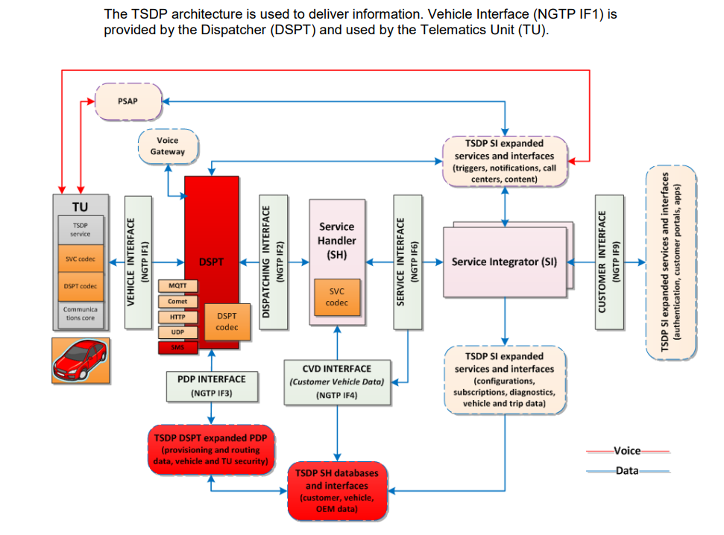
1. NGTP protocol
What is NGTP ?
TSDP - Telematics Service Delivery Platform enables the delivery of telematics services.
Better services
Open pattern
More flexibility
Global solutions
Low cost
Notes:
A platform that we have been working on since 2011 (roughly).
NGTP – Next Generation Telematics Pattern.
TSP - Telematics Service Provider
NGTP standard for high level architecture of a telematics system.
NGTP was developed in 2008 by WirelessCar, BMW and Connexis.
Aim to be an industry standard to simplify the development of telematics systems
Flexibility and Scalability
offer better connectivity and integration data and services
aimed at drivers, passengers and the vehicle itself.

Slide 4
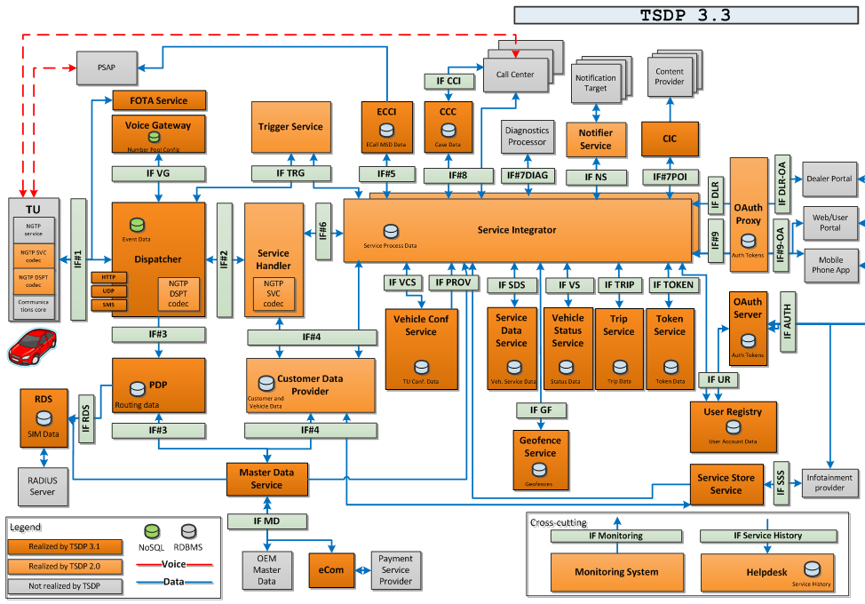
TSDP Architectural Overview
Notes:
Provisioning Data Provider (PDP)
Holds data about:
How to reach the TU (IP-address, IMSI)
Encryption (algorithm to use, keys)
Latest channel used by the TU (UDP, SMS, Comet)
QoS level for each type of service.
Which component to trigger on incoming messages.
Dispatcher : When receiving a trigger , higher components can fetch the message from the dispatcher via IF2
Service Integrator
Flow engine that handles the business logic of services.
Sends application ACKs and regular messages to the vehicle (via SH and DSPT).

Slide 5

Message Flow TU => TSP
Notes:
The dispatcher asks the PDP: ”who is interested in this message”?
PDP will answer that the SI is interested in the message.
SI => SH: please fetch the message for me.
SH => CDP get data about the vehicle.
SH fetches the message from the dispatcher
SI performs the business logic

Slide 6
Message Flow TU => TSP
Notes:
The dispatcher asks the PDP: ”who is interested in this message”?
PDP will answer that the SI is interested in the message.
SI => SH: please fetch the message for me.
SH => CDP get data about the vehicle.
SH fetches the message from the dispatcher
SI performs the business logic

Slide 7
Basic Transport Service Design Concept
NGTP
Encrypt/Decrypt
(OpenSSL, External library)
Network interfaces
(WIFI, Telephony)
Backend Server
(TSP)
Applications
Decode/Encode
(ASN)
Message management
(QUEUE,STACK, Fragments ..etc)
Transport Channel management
(UDP, HTTPS,SMS)
App Interfaces
(Receive)
TSP Interfaces
(Send)
Message Logic Processor
(Dpst ack, TTL, Priority,)
Retry and Failure
Message management
Configuration & storage
(Encryption key, Cerfificates..et)
External Services integration
( Power Manager, TCU state )
Notes:
Message Creation Time
Event Creation Time
Message ID
TTL
UplinkCount
Downlink Count
Appack,
Dsptack
How does TCU and TSP identify NGTP message ?
Equipment ID (FTU update) VIN SN
Service Type
Message Type
Message Creation Time
TTL
Payload

Slide 8
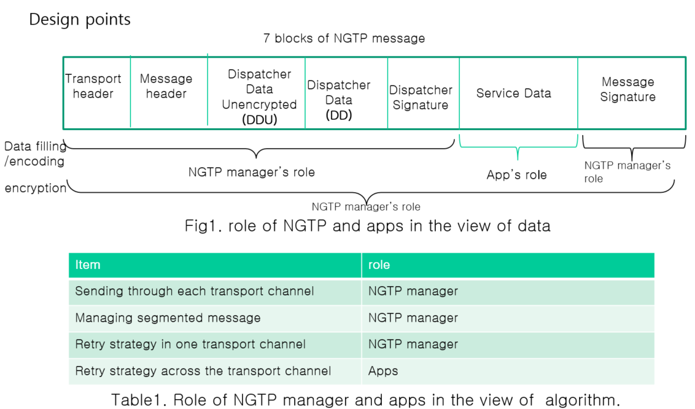
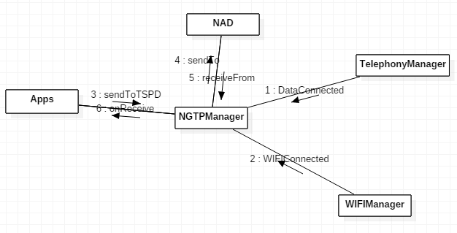
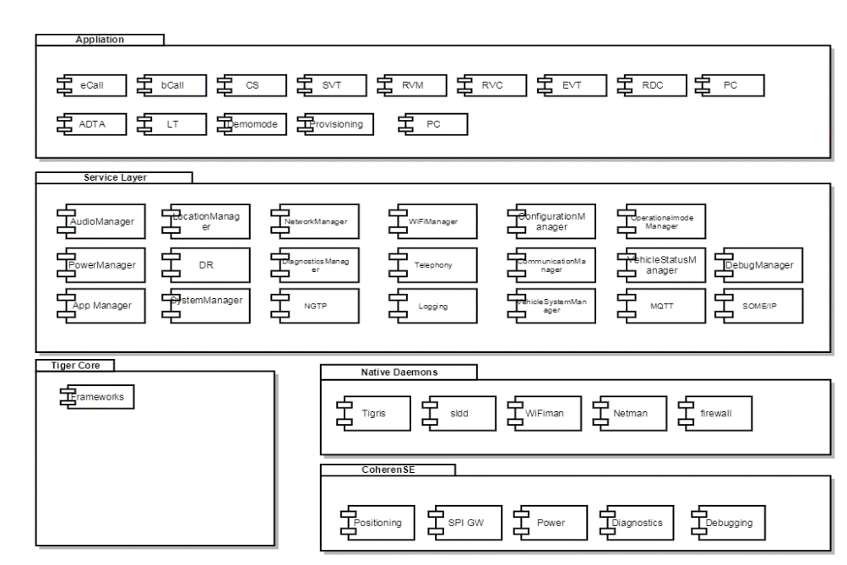
2. NGTP Manager Service Design
Payload and Integrated Modules
Receive Data status ( connection, disconnection)
Receive Wif Connection status ( connection, disconnection)
Apps send a message to NGTPManager.
NGTPManager checks the current higher prority transport channel and send the message to air through the NAD
NGTPManager receivce ack form air through the NAD.
Deliever the received message to Apps by calling onReceive

Slide 9
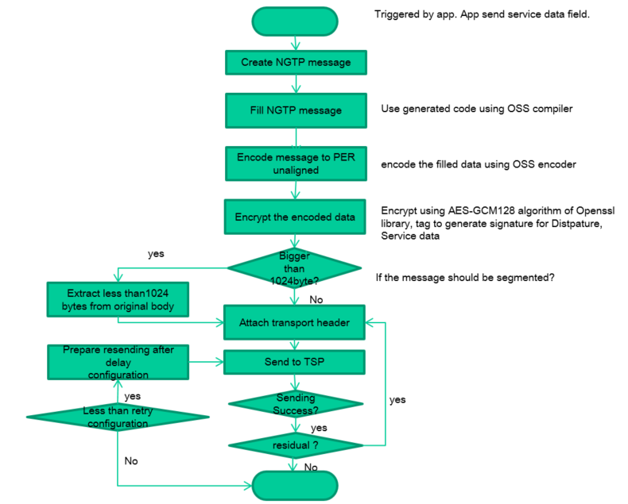
Flow chart of sending message
Notes:
Advanced Encryption
Thiết kế và độ dài khóa của thuật toán AES ( 128, 192 và 256 bit ) là đủ an toàn để bảo vệ các thông tin được xếp vào loại tối mật nhưng về an ninh của AES thì các nhà khoa học đánh giá là chưa cao. Nếu các kỹ thuật tấn công được cải thiện thì AES có thể bị phá vỡ.
Một vấn đề khác nữa là cấu trúc toán học của AES khá đơn giản.

Slide 10
3. NGTP Functions - Retry mechanism in NGTP service
Application
NGTP
TSP
Send NGTP message
.
If this is the first time retry then create retry object
NGTP Send fail due to Network issue, Backend issue ,external API issue …etc
Calculate retry delay time & increase number retry
Send fail
Message send over SMS but data disconnected
Data connected = true
Or (Data connected = false and first time retry = true)
Then push message to retry map
Get message from retry map and push back to priority QUEUE
Retry send NGTP message
Send fail
Out of number retries or delay time retry message = 0
Clean up message
Notes:
Wi-Fi : Number retries = 3
SMS : Number retries = 5
No retry for Dspt ack
TSP :
5 * UDP, 1 * SMS

Slide 11
3. NGTP Functions - Messages fragmentation and resemblance
Application
NGTP
TSP
Send fragment x/15 ( Header includes fragmentId and numbers of fragments)
Increase fragment count & ignore duplicated fragment
Send fragment 15/15
Received all fragments →resemble all fragments
Send dspt ack
Check TTL and
If it’s TCL SIM and telematics shutdown then wake up telematics & keep power
mMaximumWakeUpDuration = 70s
Forward to app
Notes:
SMS : up to 15 fragment
UDP : Normally 2 fragments
HTTPS : 1 fragment
MTU SMS = 140 bytes
MTU UDP = 1024 bytes

Slide 12
4. External Library in NGTP (1)
CURL (Opensource)
ASN (JLR library)
TLS connection (HTTPS)
TSDP is using ASN.1 to define message structures
Decode/encode payload
NGTP Manager Service
Encrypt/decrypt
Crytocomm ( JLR library)
OpenSSL (open source)
Notes:
TSDP is using ASN.1 to define the message structures
Formal definition of message data
Tools to generate encoder/decoder
ASN.1 Packed Encoding Rules Unaligned (PER/U) is used for binary encoding of payload data
Efficiently minimizing payload data
Low TU resource requirements
Benefits:
- Formal definition of message data.
Tools to generate encoder/decoder that can be used to encode/decode messages.
https://en.wikipedia.org/wiki/Packed_Encoding_Rules
PER = ASN.1 encoding rules for producing a compact transfer syntax for data structures
Unaligned = With the unaligned encoding, the bits are packed with no regard for octet (byte) boundaries. With aligned encoding, certain types of data structures are aligned on octet boundaries, meaning there may be some number of wasted padding bits. Unaligned encoding uses the least number of bits, but presumably at some cost in processing time.

Slide 13
4. External Library in NGTP (2)
Application
NGTP
TSP
Create NGTP Uplink message using ASN
Encode NGTP Uplink message using ASN (OSS)
Set NGTP Uplink information (msg creation time, server address, service type, ..etc)
Send NGTP message
PROCESS_APP_REQUEST
Push message to priority QUEUE
Encode headers
Encrypt NGTP message using Crytocomm API (Sercurity Manager)
Encrypt NGTP message using OpenSSL API (if Security Manager is not available)
Select Transport channel
Fragment message
Send NGTP message (over HTTPS using CURL)

Slide 14
5. NGTP transport
DSPT supports a number of different transport protocols
SMS
DSPT set Downlink message TTL(Time To live) and maximum allowed validity timer if this timer is timeout with received any ACK from TCU then DSPT will retry SMS message until TTL expires.
Maximum message size TCU send to TSP 140 bytes
UDP
DSPT set Downlink message TTL(Time To live) and maximum allowed validity timer if this timer is timeout with received any ACK from TCU then DSPT will retry SMS message until TTL expires.
Maximum message size TCU send to TSP is 1500 bytes
HTTPS
It is mandatory to use TLS (SSL) if using the HTTP transport
MQTT
Maximum message size TSP send to TCU is 280 bytes
Maximum message size up to 10MB.
Comet
The DSPT has experimental support for receiving NGTP messages using The MQTT protocol
Currently, JLR VDC project doesn’t support MQTT transport.
DSPT support exchange of binary NGTP messages with the TCU using Comet-based transport protocol. Comet is a long-polling HTTP implementation.
It’s mandatory to use TLS (SSL) if using the Comet transport.
Maximum message size up to 10MB.
JLR VDC : 1 segment only
JLR VDC : Able to separated to 15 segments
JLR VDC : Able to separated to 15 segments
JLR VDC : 1 segment only

Slide 15
5. NGTP transport (HTTPS)
Application
NGTP
TSP
Curl_global_init
Threadloop
Curl_easy_init (hand shake)
Curl_easy_setopt (configuration handshake)
Curl_easy_setopt (configuration post)
Curl_easy_perfrom
Send fail : curl_easy_clean → retry
Response success
Send succes
Curl_global_cleanup

Slide 16
6. NGPT Source Code - Class definition
Class | Descriptions
NGTPManagerService | This class is the main class of NGTP service. It is in charge of each handlers, processors and receivers.
NGTPDataService | This class keeps all necessary data for NGTP service
BnNGTPManagerService | Interface class of NGTP APIs
ServiceStub | Implementation class of NGTP APIs
NGTPHandler | Cmd distributer class from APPs, TSP and internal objects.
NGTPSendQueueHandler | This class is in charge of queue handling of uplink messages according to their priority.
NGTPAppRequestProcessor | This class is in charge of sending message by deciding the transport channel.
NGTPTSPRequestProcessor | This class is in charge of receiving message. it decides the receiver application and deliver the message.
NGTPRetryProcessor | This class is in charge of retry algorithm and sending.
NGTPWaitingTSDPMessage | This class is waiting-for-message class for UDP
NGTPHTTPsGet | This class is waiting-for-message class for HTTPs
NGTPSMSReceiverCallback | This class is waiting-for-message class for SMS
NGTPTransport | This class is abstract class for sending function.
NGTPTransportUDP | This class is implementation of NGTPTransport for UDP
NGTPTransportHTTP | This class is implementation of NGTPTransport for HTTP
NGTPTransportSMS | This class is implementation of NGTPTransport for SMS
NGTPCrypto | This class is in charge of encryption and decryption of NGTP message
NGTPMessage | This class is abstract class for encoding/decoding function.
NGTPMessageEncode | This class is implementation of NGTPMessage for encoding.
NGTPMessageDecode | This class is implementation of NGTPMessage for decoding.
BpNGTPReceiver | This class is interface class of message receiving on application side
IDU | Internal Data unit in-between classes
InternalNGTPData | Internal Data unit between application and NGTPManagerService

Slide 17
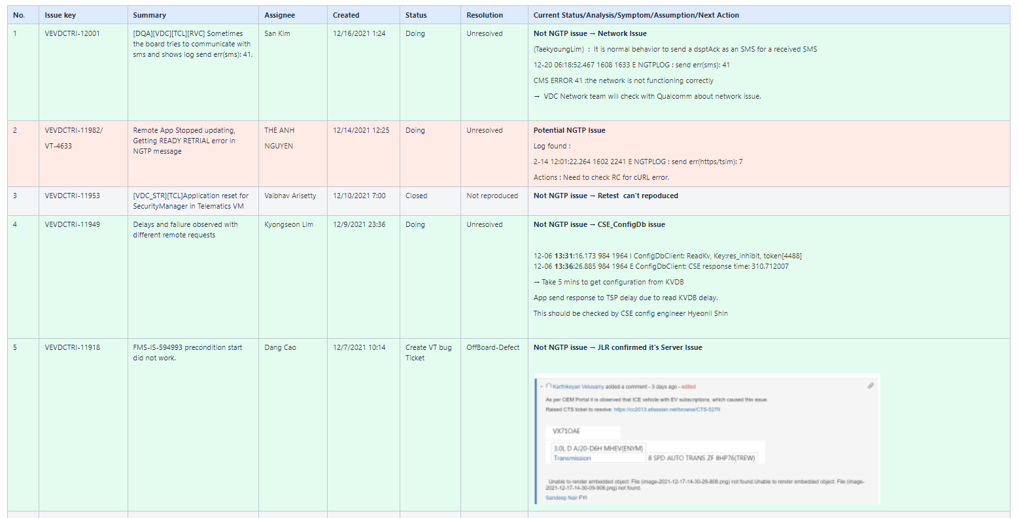
7.NGTP common Issues
Issues will be discussed on Meeting :http://collab.lge.com/main/display/~hoai.tran/Issue+Investigation

Slide 18
8. NGTP open questions
?

